Slide 2
Objectives
Describe how to create and format tables
Explain the table size and the width of a column
Explain the process of merging table cells
Explain the page layout for tables

Slide 3
Creating and Formatting Tables 1-2
A table is made up of rows and columns. The intersection of each row and column is called as a cell.
A row is made up of a set of cells that are placed horizontally.
A column is made up of set of cells that are placed vertically.
The user can represent the data in a tabular format by using the <table> element.
The <tr> element divides the table into rows and the <td> element specifies columns for each row.
By default, a table does not have a border.
The border attribute of the <table> element specifies a border for making the table visible in a Web page.

Slide 4
Creating and Formatting Tables 2-2
The Code Snippet demonstrates how to create a table.
<!DOCTYPE HTML>
<html>
<head>
<title>Languages</title>
</head>
<body>
<h2>Main Languages</h2>
<table border=”1”>
<tr>
<td>English</td>
<td>German</td>
</tr>
<tr>
<td>French</td>
<td>Italian</td>
</tr>
</table>
</body>
</html>

Slide 5
Table Headings
can specify the heading for each column in HTML by using the <th> element
The text included within the <th> element appears in bold.
<table border=”1”>
<tr>
<th>Name</th>
<th>Age</th>
<th>Place</th>
</tr>
<tr>
<td>Mark</td>
<td>17</td>
<td>Madrid</td>
</tr>
<tr>
<td>John</td>
<td>19</td>
<td>London</td>
</tr>
</table>

Slide 6
Merging Table Cells
To change the cells of a table to different height and width, colspan and rowspan attributes can be used:
colspan : specify the number of columns to span.
rowspan : specify the number of rows to span.
Spanning refers to a process of extending a cell across multiple rows or columns

Slide 7

Colspan Attribute
To span two or more columns, use the colspan attribute of the <td> and <th> elements.
The colspan attribute allows to span a cell along a horizontal row.
The value of the colspan attribute specifies the number of cells across
<tr>
<th colspan=”2”>IT</th>
<th colspan=”2”>Accounts</th>
</tr>
<tr>
<th>Name</th>
<th>Location</th>
<th>Name</th>
<th>Location</th>
</tr>
<tr>
<td>David</td>
<td>New York</td>
<td>John</td>
<td>London</td>
</tr>

Slide 8
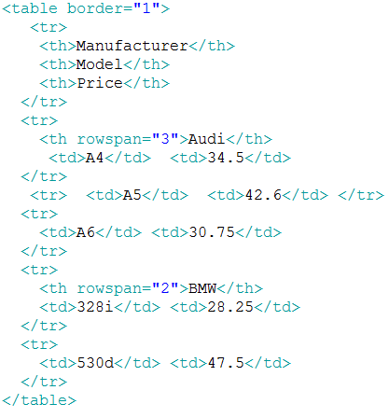
Rowspan Attribute
The rowspan attribute spans a data cell across two or more rows.
It allows to span a data cell along a vertical column.

Slide 9
Horizontal Alignment 1-2
Alignment determines the representation of text along the left, right, or center positions.
HTML5 has deprecated the align attribute.
The four possible values for setting the horizontal alignment are:
left:
center:
Aligns the data within a cell on the left side. This is the default value for table content.
Aligns the data within the cell by adjusting the text at the edges.
right:
Aligns the data within the cell on the center. This is the default value for table headings.
justify:
Aligns the data within the cell on the right side.
Notes:
Deprecate: phản đối, ko su dung

Slide 10
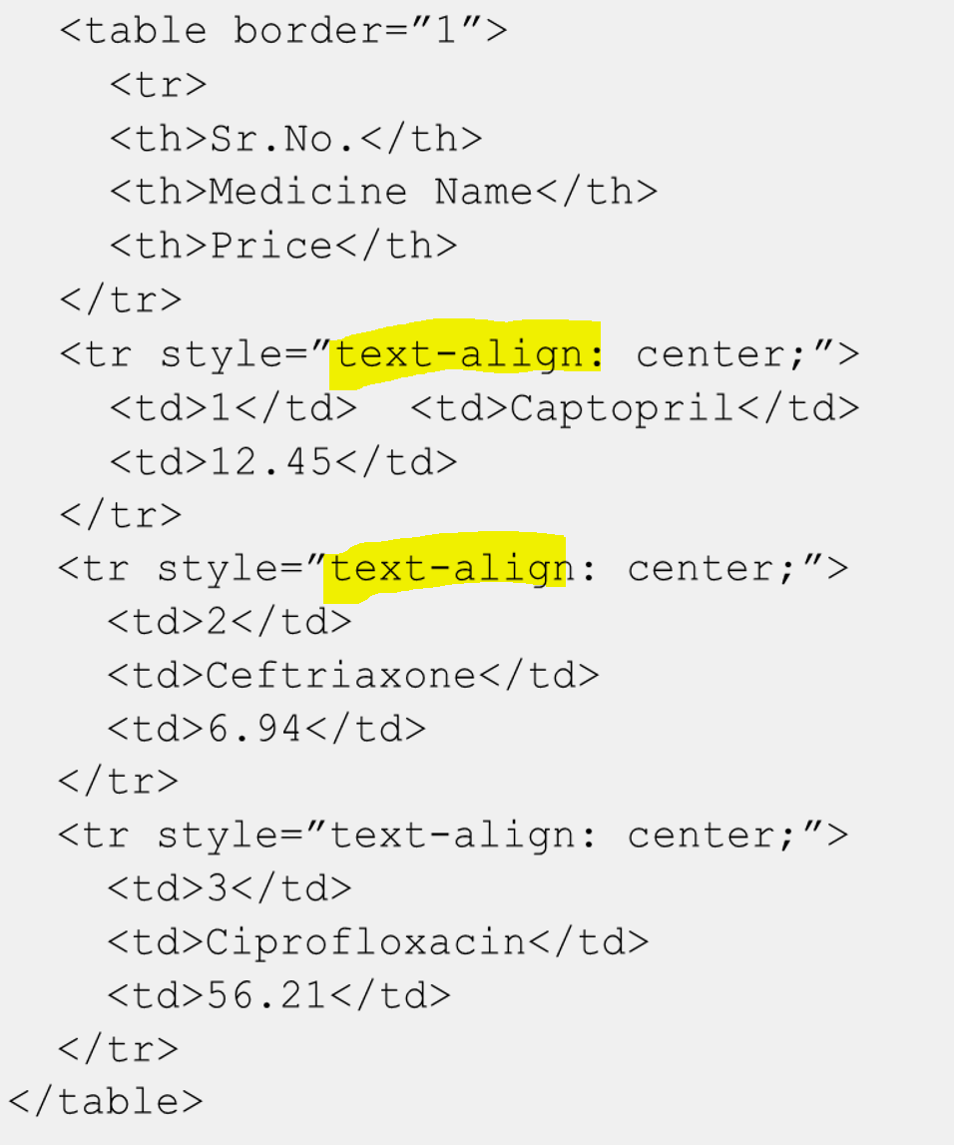
Horizontal Alignment 2-2
To set the alignment with style you can use the text-align attribute :

Slide 11
Vertical Alignment
can vertically align the position of data by using the valign attribute.
HTML5 has deprecated the valign attribute.
The possible values of vertical alignment are as follows:
top:
middle:
Vertically aligns the data within the cell at the top.
bottom:
Vertically aligns the data within the cell at the center.
Vertically aligns the data within the cell at the bottom.
Example
<td style=“text-align:center; vertical-align:middle”> Aptech Web site </td>
The style can also be applied to individual rows, cells, or to the entire table.

Slide 12
Margin Attributes
The data in a table might appear cluttered, which may affect the readability and then it is difficult to comprehend data.
To overcome this issue, use the cell margin attributes.
Padding
Padding is the amount of space between the content and its outer edge.
For tables, padding is referred as a space between the text and the cell border.
Cell padding allows the user to control the look of the content on a page.
Suppose, if the user wants to set the padding attribute for the individual cells then padding attribute can be used as follows:
<td style=”padding:4px”>
Notes:
Clutter : lộn xộn
Comprehend : hiểu

Slide 13
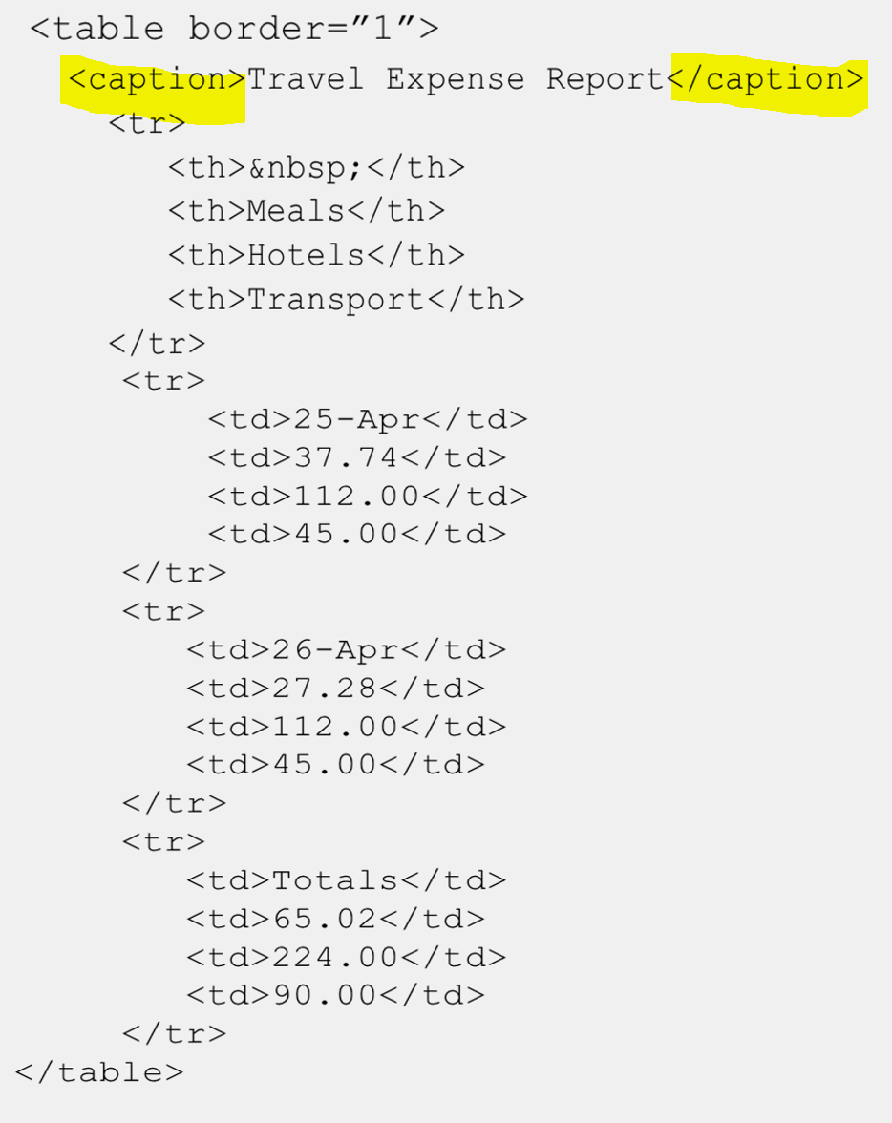
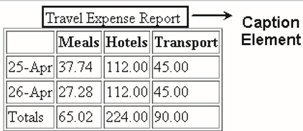
Caption Element

Slide 14
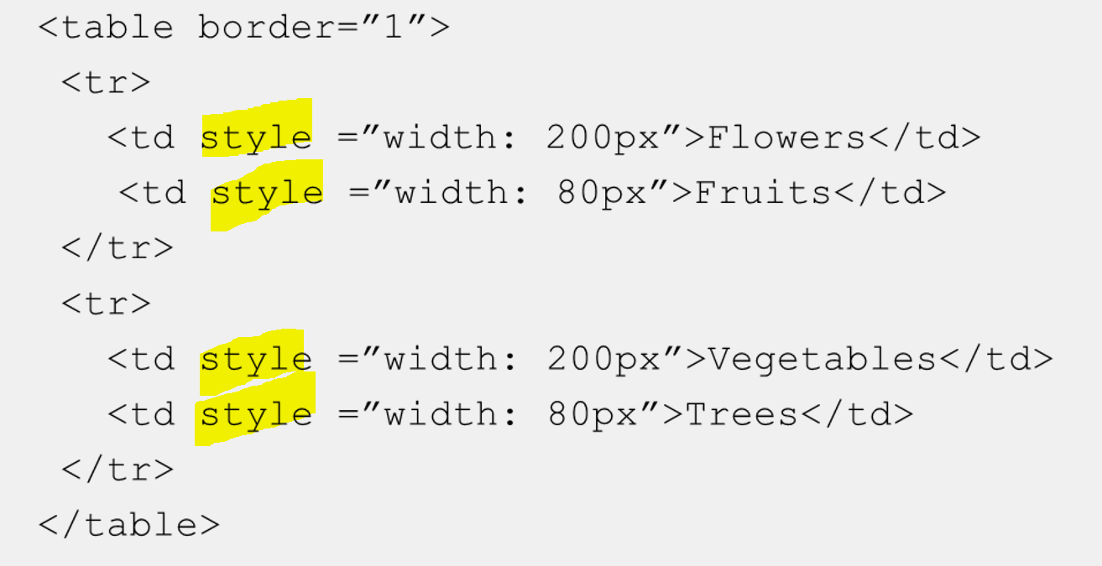

Table Size and Width of a Column
The table size can be expanded when adding more rows and columns.
to set the default width for the table , use style section in <head>
To set the width of a column in pixels, can use style attribute in the <td> tag.

Slide 15
Apply Borders by Using Styles 1-2
CSS can be used for applying borders as it is the best reliable and flexible method.
Use style based border for <table> and <td> tags as followed:
border-width:
border-color:
the thickness of the border and the values are specified in pixels.
border-style:
the color of the border specified by either name, or RGB value, or hexadecimal number.
the line style: solid, dashed, groove, dotted, outset, ridge, inset, or none.

Slide 16
Apply Borders by Using Styles 2-2
To set all these attributes at one time, can use the border attribute and place the settings in the order of width, color, and style respectively.
To format the sides of the border individually, replace the border attribute with border-bottom, border-top, border-right, or border-left attribute.
can apply these attributes to the entire table or individual cells and also create rules in the <style> area.

Slide 17
Summary
Tables allow the user to view your data in a structured and classified format.
Padding is the amount of space between the content and its outer edge.
The caption element defines a caption for a table. It is a sub-element of the <table> element.
Spanning refers to a process of extending a cell across multiple rows or columns.
The rowspan attribute spans a data cell across two or more rows.
The colspan attribute allows the user to specify the number of columns a cell should span.
The border attribute of the table element allows the user to specify a border for making the table visible in a Web page.
Tables allow the user to organize the data. It enables the developer to design a Web page having an attractive page layout.

